Slide 1
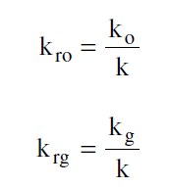
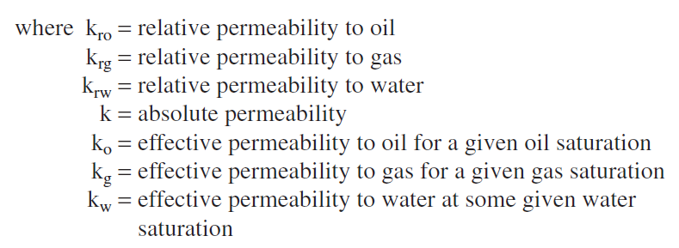
RELATIVE PERMEABILITY CONCEPTS
The absolute permeability is a property of the porous medium and is a measure of the capacity of the medium to transmit fluids.
When two or more fluids flow at the same time, the relative permeability of each phase at a specific saturation is the ratio of the effective permeability of the phase to the absolute permeability,

Slide 2
TWO-PHASE RELATIVE PERMEABILITY

Slide 5
Two-Phase Relative Permeability Correlations

Slide 6
1. Wyllie and Gardner Correlation

Slide 8
2. Torcaso and Wyllie Correlation

Slide 9
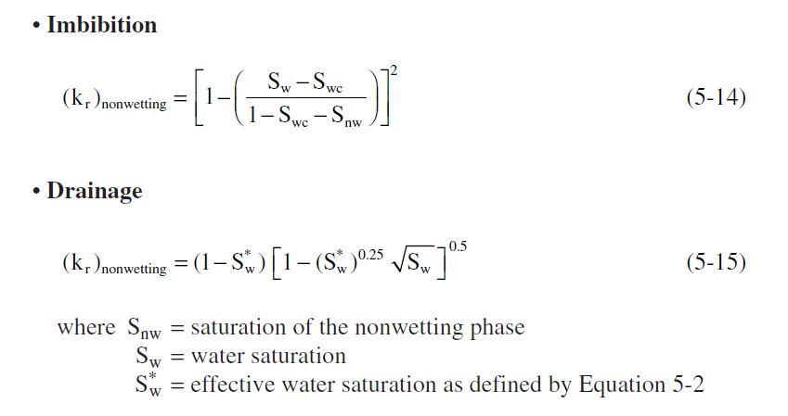
3. Pirson’s Correlation

Slide 13
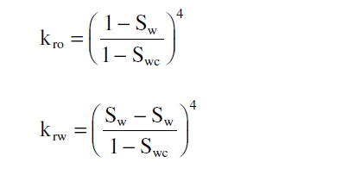
4. Corey’s Method
gas-oil system.
water-oil

Slide 14
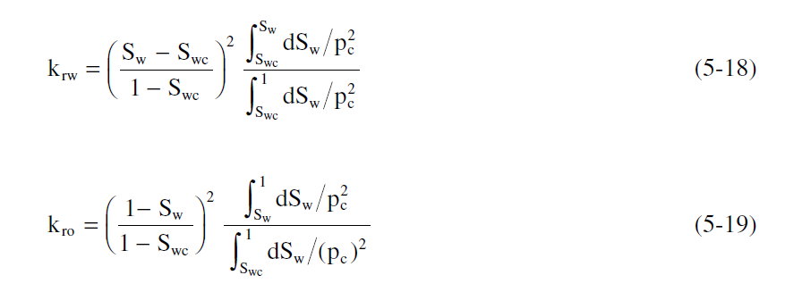
5. Relative Permeability from Capillary Pressure Data
drainage water-oil

Slide 15
oil and gas

Slide 16
6. Relative Permeability from Analytical Equations

Slide 20
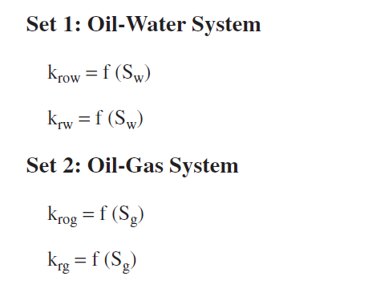
THREE-PHASE RELATIVE PERMEABILITY

Slide 23
Wyllie’s Correlations
water-wet system

Slide 25
Stone’s Model I

Slide 28
Stone’s Model II

Slide 29
The Hustad-Holt Correlation

Slide 30
